Slide 1
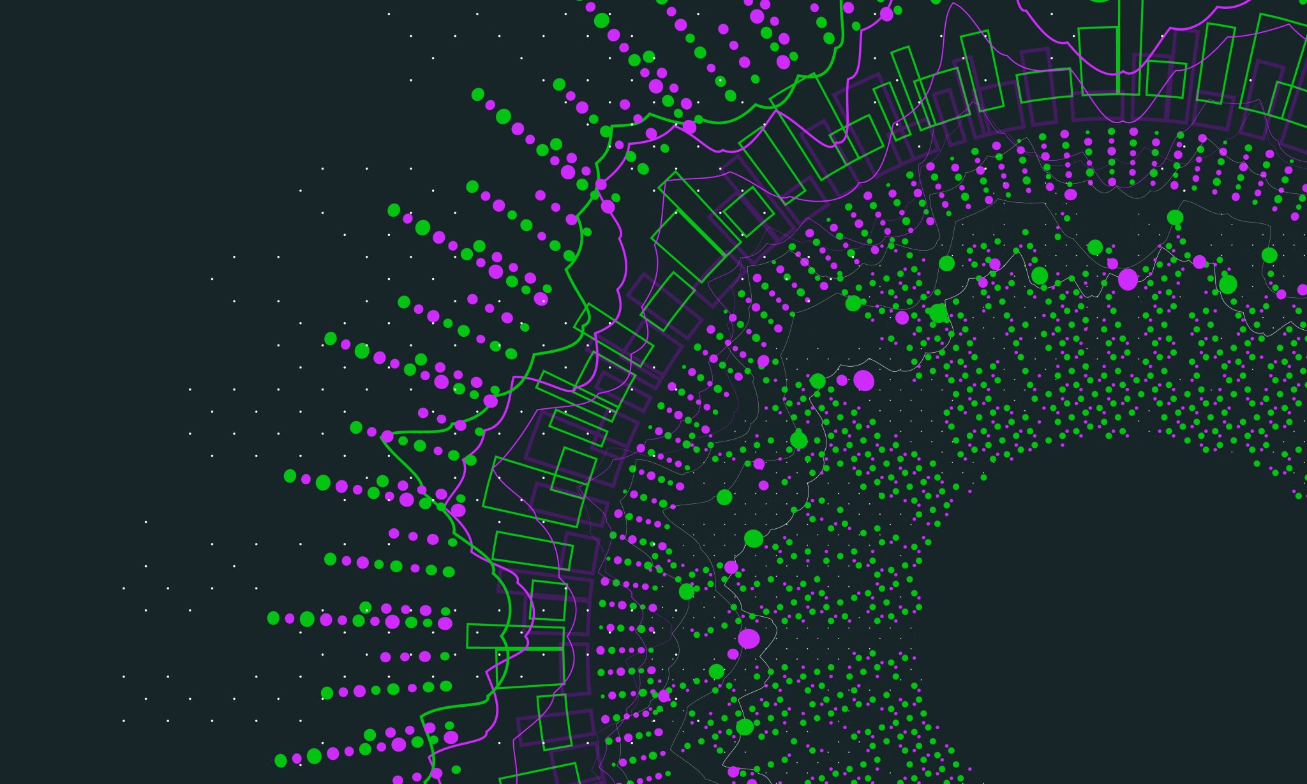
How To Amend And Improve Tests And Code
Tutorial
Notes:
In the last 2 tutorials, we learnt how to write tests and created the initial tests for our calculator application,. We also drafted code for these tests.
Now let us look at how to amend and improve these tests and code to create a completely functional program.

Slide 2
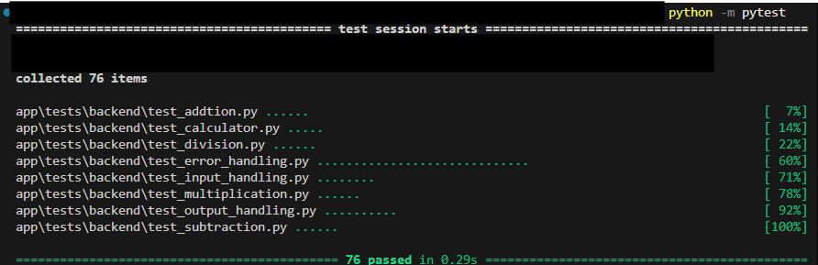
Current Tests
Notes:
Currently, after running the tests, we are shown that all tests pass!
However we are not complete yet.
These initial tests were written to meet the basic requirements identified.

Slide 3
Amend and Improve
Amend
Improve
Notes:
We must now amend and improve both our tests and code, where we amend it by adding missing test cases we did not account for yet, and improve it by making the tests and code clearer if possible.
This process of amending and improving is repeated until a complete and fully functional program.

Slide 4

Amend Tests
Missing edge cases
Empty input values
Notes:
Let’s amend our tests by going back to our initials tests and identify any edge cases missed.
The only edge case missing is for empty input values, which should return an error and therefor will be part of the error handling category.

Slide 5
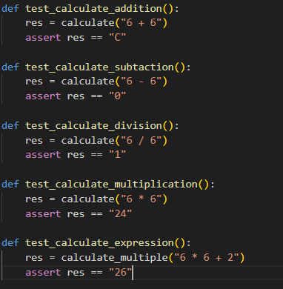
Improve Tests
Notes:
To improve the functionality of the calculator program, we will make a new class that calls input handling, the arithmetic functions based on the operator in the user’s input and the out handling function to determine if the output from the arithmetic calculations is valid.

Slide 6

Improve Tests
Notes:
Improving tests also include renaming test cases to be more descriptive, for example test_calculate_addition does not tell you anything specific, we should rename it to test_calculate_addition_success. This should be done for every test.

Slide 7

Amend Code
Missing edge cases
Empty input values
Notes:
We must now amend the code to match the amendments made to our tests.
So we must add error handling for empty input to our handle_input function.

Slide 8
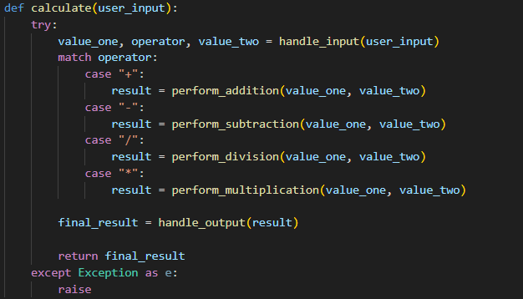
Improve Code
Notes:
Lastly, to improve our code we will code the calculate function that can take will be able to take in any input for subtraction, addition, multiplication or addition and handle it in 1 function.
We should repeat this cycle of amending and improving until a fully functional application has been created.

Slide 9
Next Step
Migrate Tests into GitHub Actions
Notes:
Finally, tests and code have been amended and improved, and they all pass.
In the next tutorial, you will learn how to migrate the tests into GitHub Actions.

